Slide 1
Spark MLlib
Dingtinghe
dingtinghe@chinatelecom.cn

Slide 2
Data Types
local vectors
stored on a single machine
labeled point
stored on a single machine
local matrices
stored on a single machine
distributed matrices
stored distributively in one or more RDDs

Slide 3
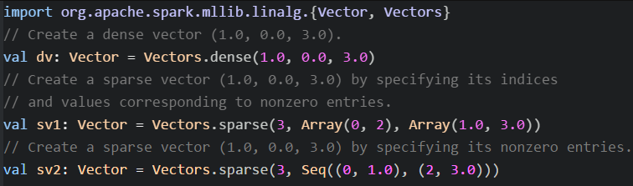
Local vector
integer-typed and 0-based indices and double-typed values
dense vector
backed by a double array representing its entry values
sparse vector
backed by two parallel arrays: indices and values

Slide 4
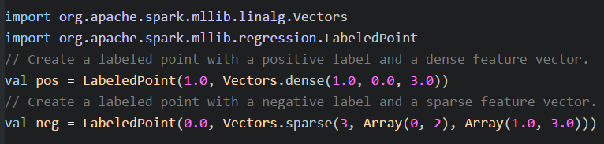
Labeled point
A local vector, either dense or sparse, associated with a label/response.
Be used in supervised learning algorithms.

Slide 5
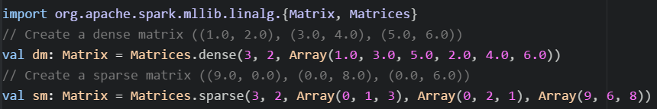
Local matrix
integer-typed row and column indices and double-typed values
dense matrices
entry values are stored in a single double array in column-major order
sparse matrices
non-zero entry values are stored in the Compressed Sparse Column (CSC) format in column-major order.

Slide 6
Distributed matrix
long-typed row and column indices and double-typed values
RowMatrix
without row indices and backed by an RDD of its rows, where each row is a local vector.
IndexedRowMatrix
is similar to a RowMatrix but with meaningful row indices
backed by an RDD of indexed rows, each row is represented by index and a local vector.
CoordinateMatrix
backed by an RDD of its entries, and each entry is a tuple of (i: Long, j: Long, value: Double)
used only when both dimensions of the matrix are huge and the matrix is very sparse.
BlockMatrix
backed by an RDD of MatrixBlocks, where a MatrixBlock is a tuple of ((Int, Int), Matrix)

Slide 7
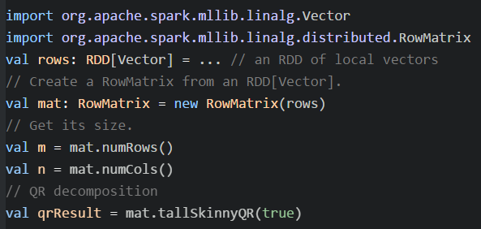
RowMatrix
A RowMatrix can be created from an RDD[Vector] instance.
We can compute its column summary statistics and QR decompositions.

Slide 8
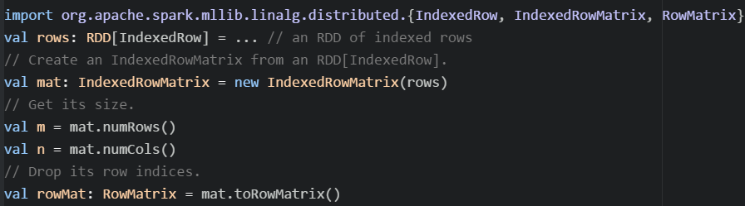
IndexedRowMatrix
Created from an RDD[IndexedRow] instance, where IndexedRow is a wrapper over (Long, Vector).
IndexedRowMatrix be converted to a RowMatrix by dropping its row indices.

Slide 9
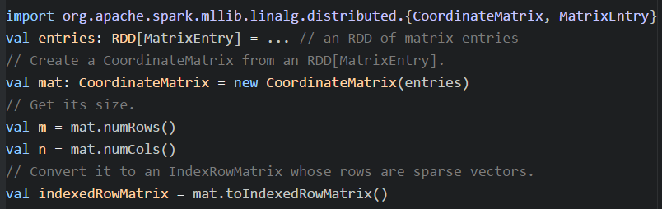
CoordinateMatrix
created from an RDD[MatrixEntry] instance, where MatrixEntry is a wrapper over (Long, Long, Double).
be converted to IndexedRowMatrix with sparse rows by call toIndexedRowMatrix.

Slide 10
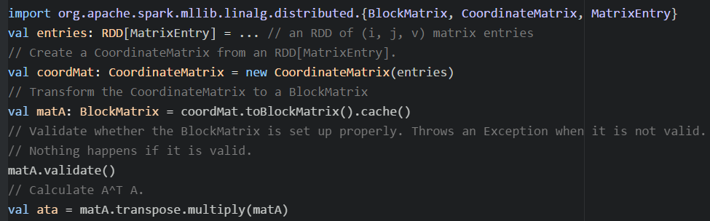
BlockMatrix
Created from IndexedRowMatrix or CoordinateMatrix by calling toBlockMatrix.

Slide 11
Basic Statistics
Summary statistics
Correlations
Stratified sampling
Hypothesis testing
Random data generation
Kernel density estimation

Slide 12
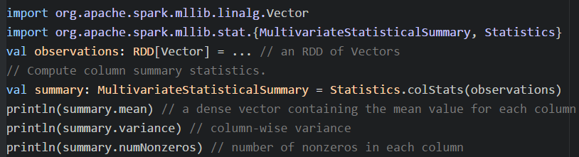
Summary statistics
for RDD[Vector], colStats returns an instance of MultivariateStatisticalSummary
contains the column-wise max, min, mean, variance, and number of nonzeros, total count.

Slide 13
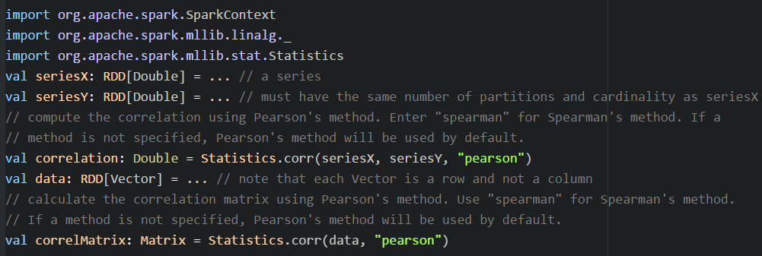
Correlations
Support Pearson’s and Spearman’s correlation between two series of data
Depending on the type of input, two RDD[Double]s or an RDD[Vector], the output will be a Double or the correlation Matrix respectively.

Slide 14
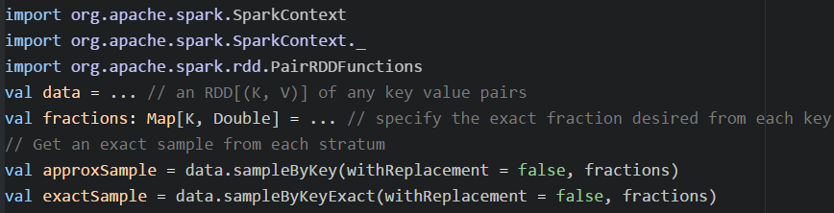
Stratified sampling
Can be performed on RDD’s of key-value pairs, the keys can be thought of as a label and the value as a specific attribute. Set replacement or not.
sampleByKey
sampleByKeyExact
requires more resources, but provide exact sampling size with 99.99% confidence

Slide 15
Hypothesis testing
Supports Pearson’s chi-squared ( χ2) tests for goodness of fit and independence
The goodness of fit test requires an input type of Vector
The independence test requires a Matrix as input.
Supports the input type RDD[LabeledPoint] to enable feature selection
MLlib provides a 1-sample, 2-sided implementation of the Kolmogorov-Smirnov (KS) test for equality of probability distributions

Slide 16
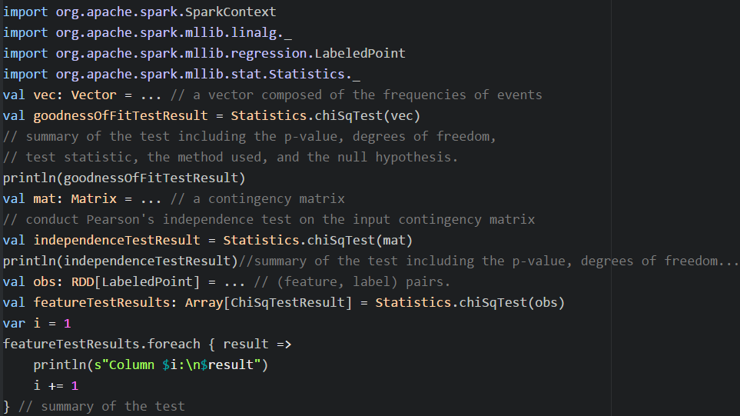

Slide 17
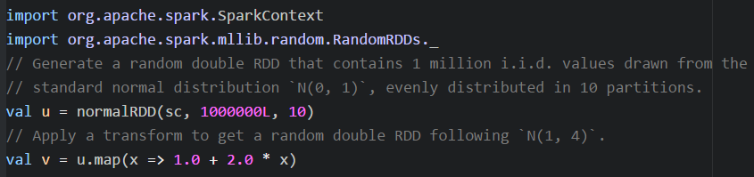
Random data generation
Be useful for randomized algorithms, prototyping, and performance testing.
Generating random double RDDs or vector RDDs drawn from a distribution: uniform, standard normal, Poisson.

Slide 18
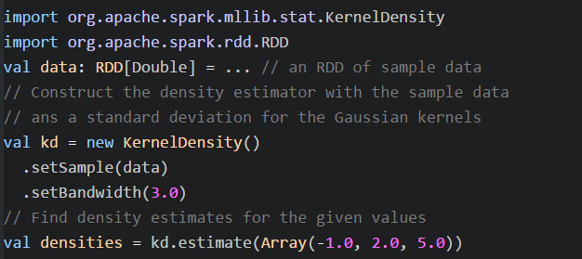
Kernel density estimation
Be a technique useful for visualizing empirical probability distributions without requiring assumptions about the particular distribution
It computes an estimate of the probability density function of a random variables, evaluated at a given set of points.

Slide 19
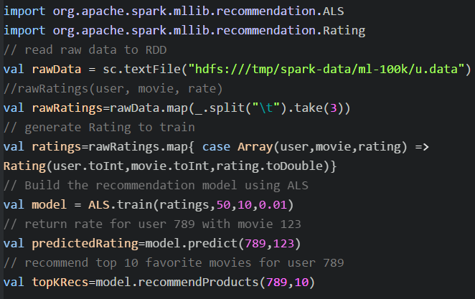
Example: recommender systems

Slide 20
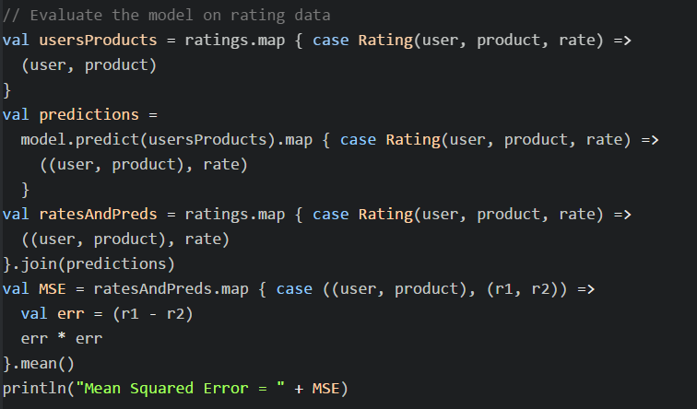
Evaluate the model with MSE

